Slide 1
NYC 311 project

Slide 2
Feature Engineering - Methodology
First, I picked each feature in the dataset and thought if any new feature could be or should be created through that feature.
Second, I understood and analyzed various 311 complaint types using description of complaints and through online research. Then for each complaint type, I tried to brainstorm features which can help the model differentiate it from other complaints.
Brainstorming through logic and intuition.
* A feature which I missed out on creating was using external data to gauge the average income of each neighborhood.

Slide 3
Forecasted variable
Top 21 complaint types: 80% records
Top 42 complaint types: 90% records

Slide 4
LightGBM - Hyperparameter tuning Best parameters
Best max_depth: 22
Best number of trees: 49
Should have used max_depth instead as 22 is high an may lead to overfitting.
There is still scope for parameter tuning.

Slide 5
Model Results and Usage
Weighted Average Precision: 69%
Weighted Average Recall: 69%
For optimizing resource allocation so that incidents can be resolved in less time and overall costs are reduced.
Model is trained for 80% complaints. Thus, 69%*80%=55% correct predictions.

Slide 6
Using the model
For optimizing resource allocation so that incidents can be resolved in less time and overall costs are reduced.
Model is trained for 80% complaints. Thus, 69%*80%=55% correct predictions.
Set optimal probability threshold for each class (complaint type) so that we can know whether a complaint type will actually occur at a location or not.
Predict what incidents will happen at which location at what hour (time) and allocate resources accordingly.
*More optimization can be achieved by using top 3 predictions.

Slide 7
Analytics
Data Analytics can be used to cover the complaints not predicted correctly by the model and the remaining 20% records for further enhancing resource allocation.
Both ML model and analytics-based decisions can be used to test which approach works better using A/B testing.
To verify whether decisions based on the ML model make sense.

Slide 8
Why Geospatial?
For more intuitive visualization.
To analyze distance of incident locations (zip codes) with precinct locations so that better resource allocation and efficient issue resolution can be done.
To use with google maps API to visualize estimated time for resolving complaints. If estimated time taken to reach the incident is too much, then better resource allocation should be done based on zip codes on the map.

Slide 9
Data Filtering for Visualizations Important Filters
Complaint Type
Agency
Month
Day of month can be used for analysis during festivals like Halloween/Christmas
Phase of day / Hour of day
Weekend ?
Downtown ?
Season

Slide 10
Analysis of complaints Hiring workers and Inventory management by analyzing frequency of complaints and their yearly trend
Enter a complaint type to analyze the total number of various complaints over the years.
Inventory is ordered based on specific complaints, not the complaint types. So, we analyze at a complaint level.
For each complaint, we see the trend over the years and using the past occurrences we can order inventory.
Usually, the minimum required inventory can be purchased initially and then more can be bought as the year ends.

Slide 11
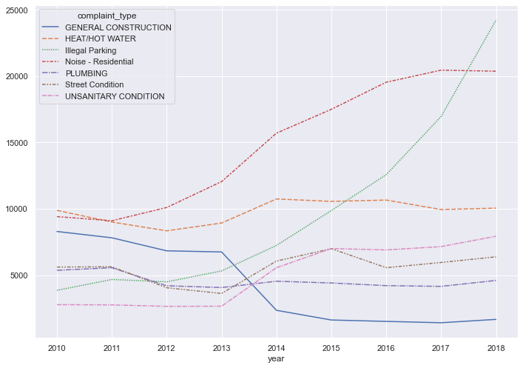
Analysis of Complaint Types For efficient hiring and training of workers using yearly trend

Slide 12
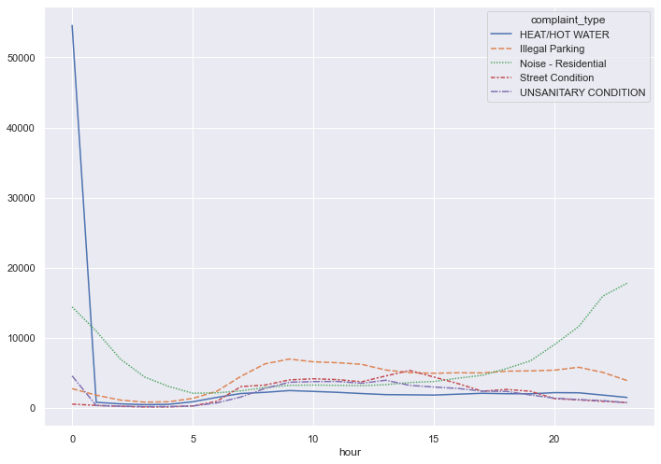
Hourly trends For planning shift timings for workers

Slide 13
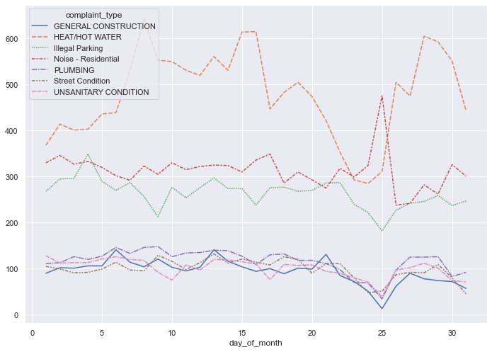
Analyzing at day level For analyzing important days such as Christmas, Halloween etc.

Slide 14
Correlation of complaint types at week level
Issues of paint-plaster, general construction and plumbing occur in the same period.
Issues of building/use, unsanitary conditions and rodent occur in the same period.
Issues of noise, rodent and unsanitary conditions also occur in the same period.
Street Light Condition, Building/Use, General construction, Illegal parking occur in the same period.
Traffic signal and plumbing occur in the same period.
Electric issues, Illegal parking and General construction occur in same period.

Slide 15
Correlation of complaint types at community board level
Electric, Paint/Plaster, Plumbing and Door/Window issues occur in the same areas.
General Construction, NONCONST, Paint/Plaster and Plumbing occur in same areas.
Sewer, Missed Collection and Damaged Tree issues occur in the same areas.
Heat/Hot water, Paint/Plaster, Plumbing and NONCONST occur in the same areas.

